Slide 1
2026 Model of Care Training
AbilityCare and SeniorCare Complete

Slide 2
About South Country
South Country is a county-based purchasing health plan serving seven Minnesota counties (Brown, Dodge, Goodhue, Sibley, Steele, Wabasha and Waseca)
We offer plans/programs for Minnesota Health Care Program enrollees
South Country has over 25,000 members in 7 plans/programs
We work closely with health care providers and county public health and social service departments to support wellness

Slide 3
Table of Contents
Model of Care (MOC) Training Purpose and Requirement
Our Special Needs Plans
Care Coordination
Transitions of Care
The Interdisciplinary Care Team (ICT)
Clinical Practice Guidelines
Goals and Summary

Slide 4
Training Purpose
Provide information about our Models of Care for AbilityCare and SeniorCare Complete and the annual training requirement for these plans
Provide information on your role as a provider
Explain to how to collaborate with the care coordination team

Slide 5
Models of Care and Training Requirements
The Centers for Medicare and Medicaid Services (CMS) requires Medicare Special Needs Plans (SNPs) to submit and receive approval for their Model of Care (MOC)
A SNP MOC is considered a vital quality improvement tool for ensuring the unique needs of each member enrolled are identified and addressed
Annual training is required for network providers and out-of-network providers seen by enrollees on a routine basis

Slide 6
Our Special Needs Plans
SeniorCare Complete (a Minnesota Senior Health Options (MSHO) Plan and Medicare Fully Integrated Dual Eligible SNP
  Includes Medical Assistance, Medicare (Parts A, B and D) and Elderly Waiver services (home and community-based services for those who are eligible)
  Members have one ID card
  Members are assigned a care coordinator
AbilityCare (a Special Needs BasicCare Plan and Medicare Highly Integrated Dual Eligible SNP
  Includes Medical Assistance and Medicare (Parts A, B and D)
  Members have one ID card
  Members are assigned a care coordinator

Slide 7
SeniorCare Complete Demographic and Health Status Information
Eligibility | Age Range | Gender | Living Arrangement | Race and Language | Health Status Information
Must be: Age 65 or older, Eligible for Medical Assistance and Medicare Parts A and B, and Reside in our service area | 65+ | Female: 68.5% Male: 31.5% | Community: 77% Facility: 23% | 94% White 97% English speaking | Avg. No. of Chronic Conditions: 5 Avg. No. of Primary Care Visits/Year: 5 Top 5 Chronic Conditions: Hypertension Hyperlipidemia Chronic Kidney Disease Depression Arthritis

Slide 8
AbilityCare Demographic and
Health Status Information
Eligibility | Age Range | Gender | Living Arrangement | Race and Language | Health Status Information
Must be: Age 18-64, Eligible for Medical Assistance and Medicare Parts A and B, and Reside in our service area Be certified disabled through the Social Security Administration or State Medical Review Team | 18-64 | Female: 45% Male: 55% | Community: 89% Facility: 11% | 96% White 99% English speaking | Avg. No. of Chronic Conditions: 4 Avg. No. of Primary Care Visits/Year: 8 Top 5 Chronic Conditions: Anxiety Disorders Depression Hypertension Hyperlipidemia Fibromyalgia, Chronic Pain and Fatigue

Slide 9
Our Special Needs Plans Provider Network
Our network includes but is not limited to:
  Primary care providers
  Specialists
  Dental providers
  Behavioral health providers
  Skilled nursing facilities

Slide 10
Care Coordination
Each member is assigned a care coordinator
Care coordinators assist members by:
  Conducting health risk assessments
  Developing individualized care/support plans
  Communicating with the interdisciplinary care team
  Closing care gaps
  Facilitating transitions of care

Slide 11
Health Risk Assessments
Health risk assessments (HRAs) are conducted after enrollment and annually thereafter (unless a member refuses or is unable to be reached) by care coordinators
Assess medical, functional, cognitive, psychosocial and social determinants of health needs
Help in developing an individualized care/support plan

Slide 12
Individualized Care/Support Plans (ICPs)
ICPs are person-centered
Help address needs identified in the HRA
Include goals
Are shared with the member’s chosen interdisciplinary care team (ICT) participants
An ICT Communication Form is sent to the member’s primary care provider at least annually at the time the ICP is developed

Slide 13
The Interdisciplinary Care Team
Members select their ICT
Care coordinators are responsible to facilitate communication and exchange between all participants
ICTs may include providers, specialists, caregivers, authorized representatives, etc.

Slide 14
Transition of Care Protocols
Care coordinators assist with transitions of care
  They communicate with the ICT
  Provide support and coordinate needs
  Help member’s understand discharge instructions, changes to medications and follow-up appointments needed/arranged

Slide 15
Clinical Practice Guidelines
Our clinical practice guidelines are adopted from multiple nationally recognized sources, such as:
  U.S. Preventive Services Task Force
  American Diabetes Association
  Global Initiative for Asthma
  American Heart Association
  American College of Cardiology
  American Psychological Association
Please see Chapter 7 in our Provider Manual on our website for more information

Slide 16
MOC Goals – Care Coordination & Member Engagement
Initial Health Risk Assessment:
100% of enrollees complete an initial health risk assessment within required timeframe.
Annual Health Risk Assessment:
100% of enrollees complete an annual health risk assessment within 365 days of previous assessment.
Individual Care Plan Development:
100% of enrollees develop an individual care plan, that includes identifying their ICT, within 30 days of completed health assessment.
Timely Follow-Up:
100% of enrollees (or their representative) contacted within one business day for follow-up after a health care event, when notified within 14 days.
These goals support proactive, personalized care and timely interventions for all members.

Slide 17
MOC Goals – Member Health & Quality of Life
Medication Reconciliation Post-Discharge:
100% of enrollees discharged from hospital complete medication reconciliation within 30 days of discharge (following HEDIS specifications for Med Rec Post-Discharge).
Ambulatory/Preventive Care Visits:
100% of members aged 20 and older had an ambulatory or preventive care visit.
Diabetes Management:
100% of members aged 75 and under with diabetes have an HbA1c that is less than 9%.
Hypertension Control:
100% of members aged 85 and under with hypertension have blood pressure that is <140/90 mm Hg.
All measures aim for a 100% target rate to ensure optimal outcomes for members.

Slide 18
Summary
A SNP MOC is considered a vital quality improvement tool for ensuring the unique needs of each member enrolled are identified and addressed
Annual training is required for network providers and out-of-network providers seen by enrollees on a routine basis

Slide 19
Community Engagement Contacts
South Country’s community engagement team oversee our Models of Care and our care coordinators
Please reach out with any questions:
  communityengagement@mnscha.org; or
  1-866-722-7770 (ask to speak with our care management team)

Slide 20

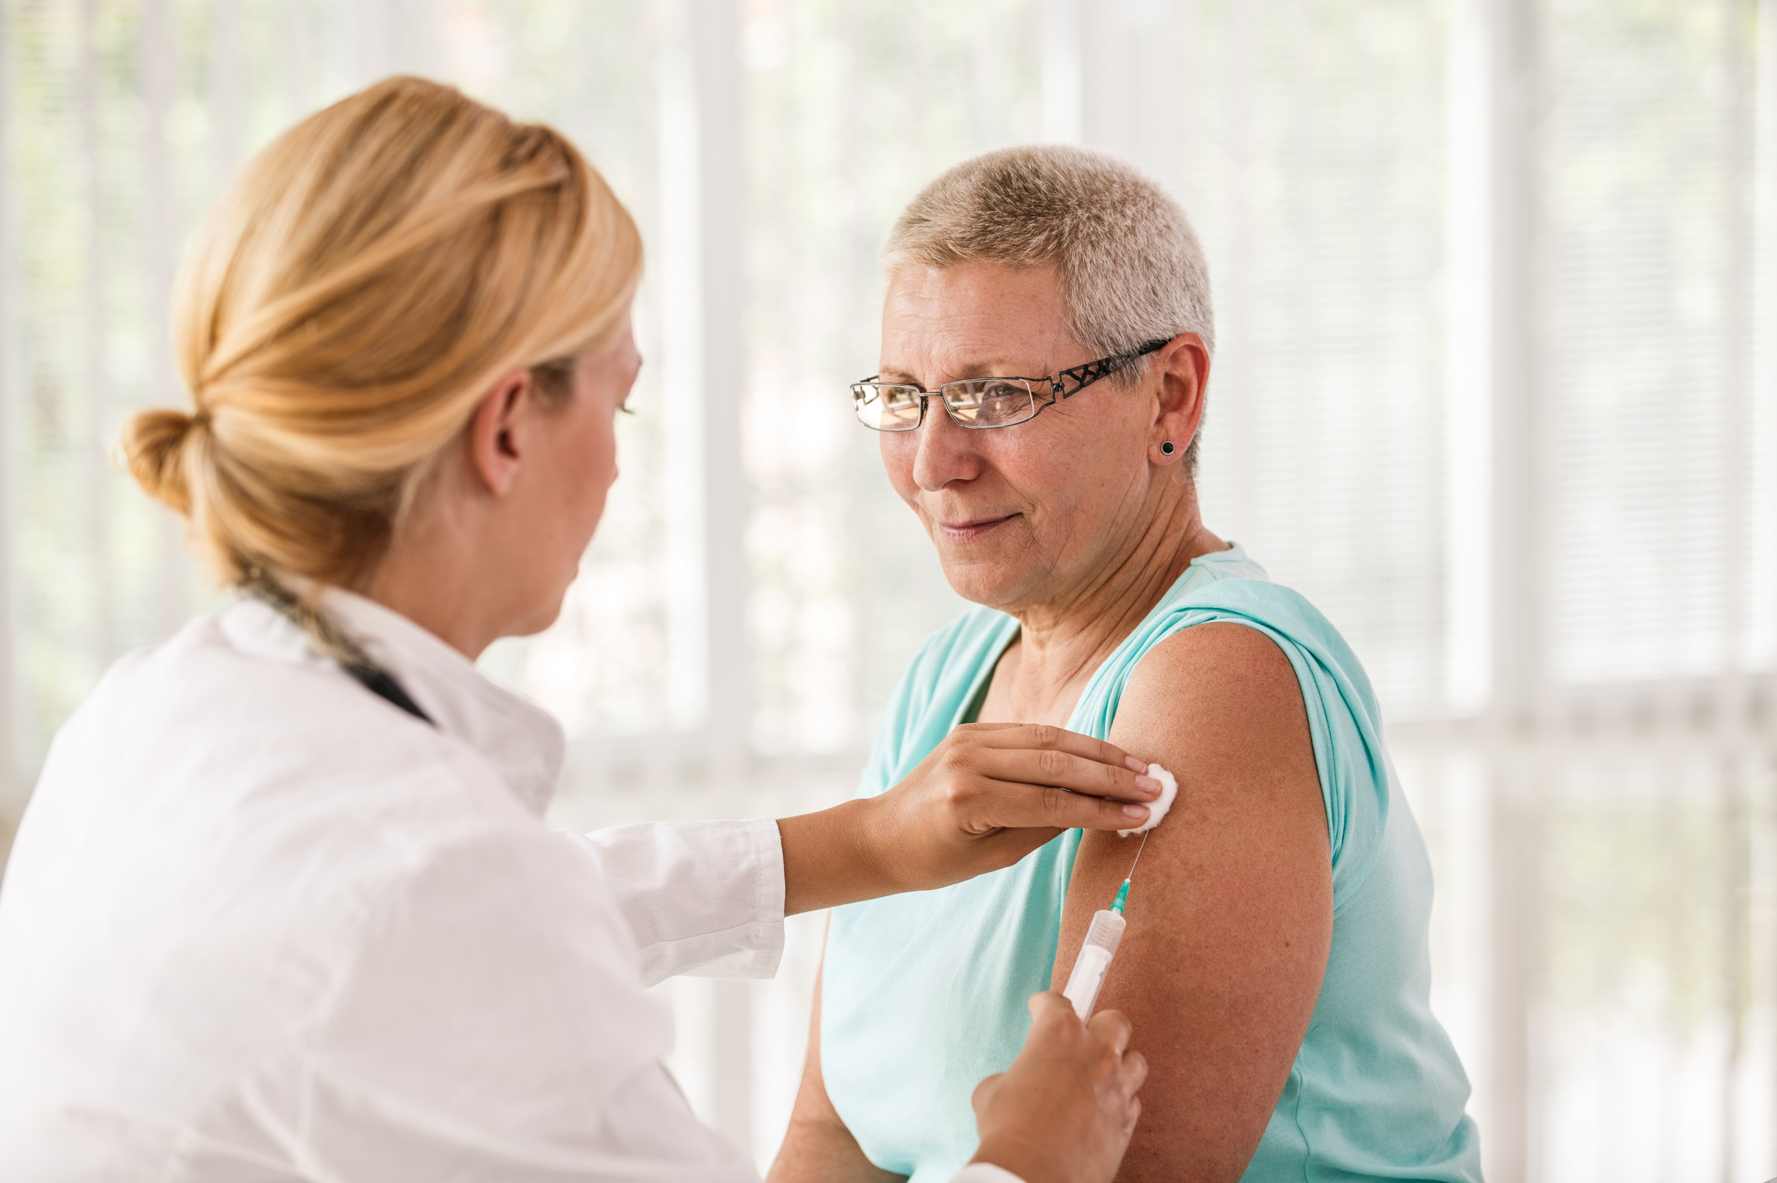

Local. Responsive. Reliable.
Thank you for providing care to our members and for completing this training.

